Slide 1

MS Project
November 2025

Slide 2
Day 1
Introduction
Step-by-step plan
Settings
Task 1
Project information
Task 2
Calendars
Work Breakdown Structure
Guided tour
Tasks
Task 3
Plans, tasks & Reports
  Create project plan
  Inserts Tasks & Dependencies
  Add Resources & Allocate
  Reports
  Analyzes
  Adapt a project
Link to files

Slide 3
Become acquainted
Company
Nature of the work (in relation to projects)
Experiences (Office / MS-project)
What is your objective?
What do you want to learn?
Notes:
Voornaam
Achternaam
E-mailadres
Anita
Drost
a.drost@enschede.nl
Berdien
Knottenbelt
b.knottenbelt@enschede.nl
Kenneth
Bunskoek
kenneth.bunskoek@tecnotion.com

Slide 4
Why MS Project
Can be more productive and get better results by using the set of features that Project provides.
You can use Project to:
Create plans at the level of detail that's right for your project. Working with summary
data initially and then switch to a more granular approach if necessary.
Tasks can be scheduled automatically, and which tasks you want to schedule
Manual scheduling.
Manage tasks, resources, work, and costs at any level of detail
Work with your plan's data in a variety of views and reports.
Track and manage your plan throughout the project's lifespan.
Collaborate and share data with others in your organization.
Use resource pools, consolidated projects, and links between projects to optimize your
Focus on project management across multiple projects

Slide 5
Step-by-step plan
Initiation
Baseline plan
Management of the project

Slide 6
Steps
 | Step
1 | Definition | Start date, PM, acceptance criteria
2 | Calendar | Bank holiday, vacations
3 | Work Break Down | Structure based on tasks, or products, how detailed
4 | Dependencies | Fase’s, logical sequence, lags
5 | Constrains | Deadlines, other projects
6 | Resources | Men, machines, materials
7 | Assignments | Resources assign to tasks, availability resources
8 | Check allocations | Over allocation, lags between work
9 | Progress | Now the work starts: monitor every week the progress and adjust the plan
10 | Re-plan | Milestones, resources, tasks, changes
12 | Report | Management information, progress reports

Slide 7

MS-project
Basis
  Project
  Task
  Resource
work
Percentage
available
duration

Slide 8
Start a project

Slide 9
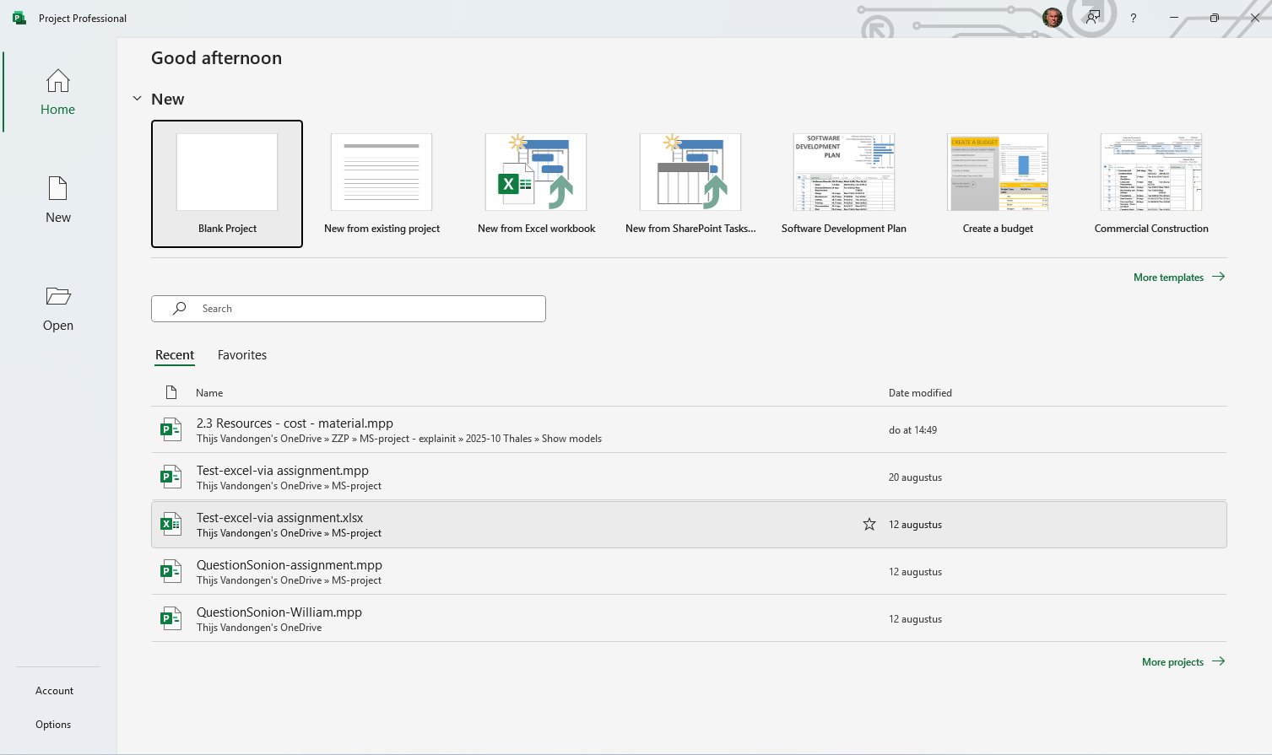
Start a project
Escape <Esc>
Blank project

Slide 10
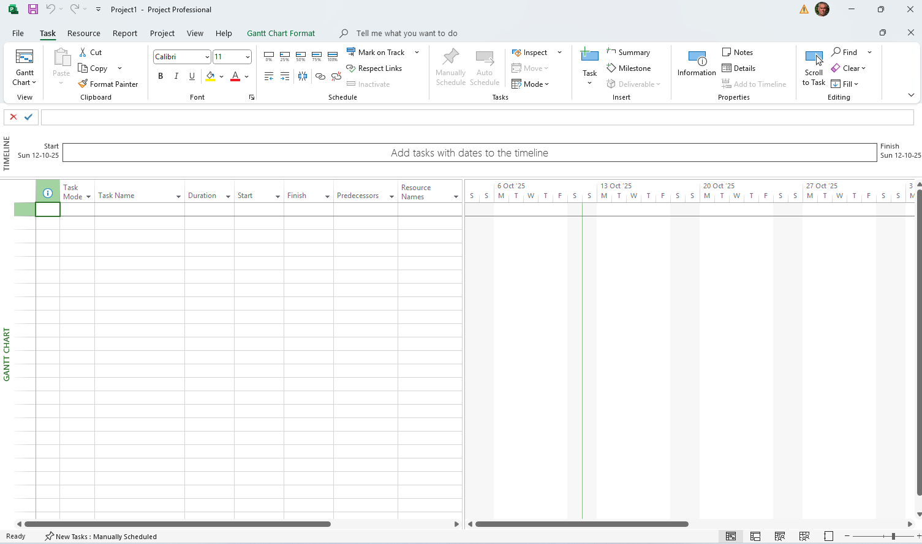
Start a project

Slide 11
Settings

Slide 12
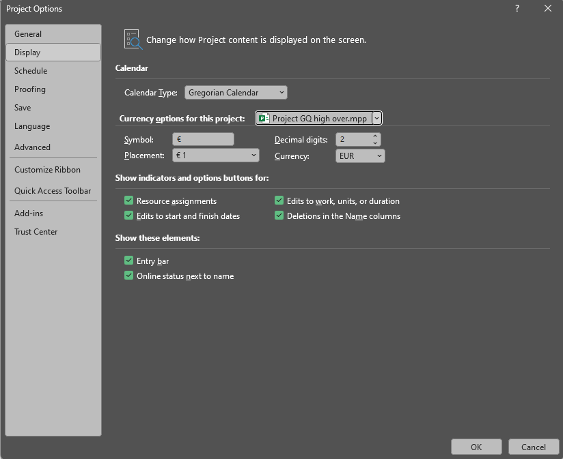
Euro settings & Entry bar
File
Options

Slide 13
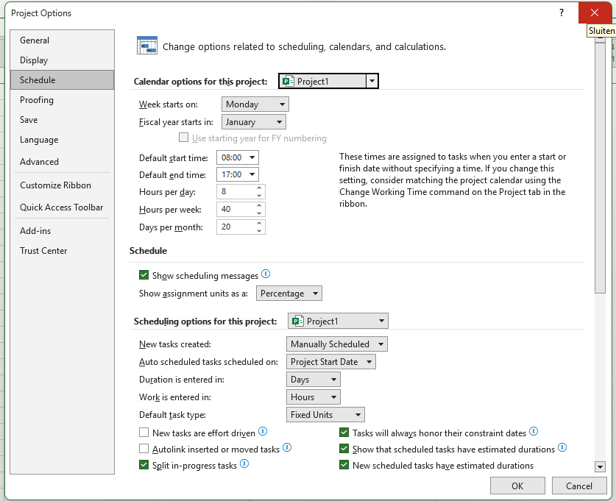
Schedule
Recommendation
Autolink: disabled
Notes:
Neem alle opties mee

Slide 14
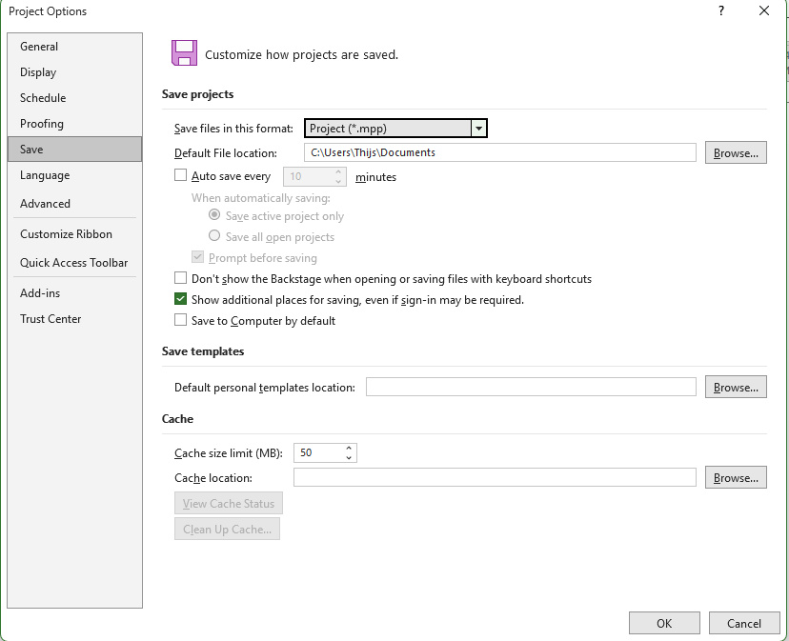
Autosave
Recommendation
Auto save: disabled

Slide 15
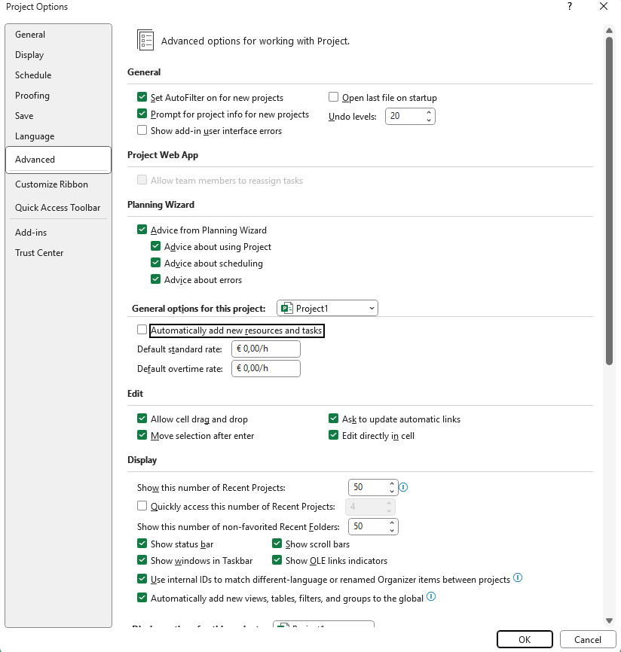
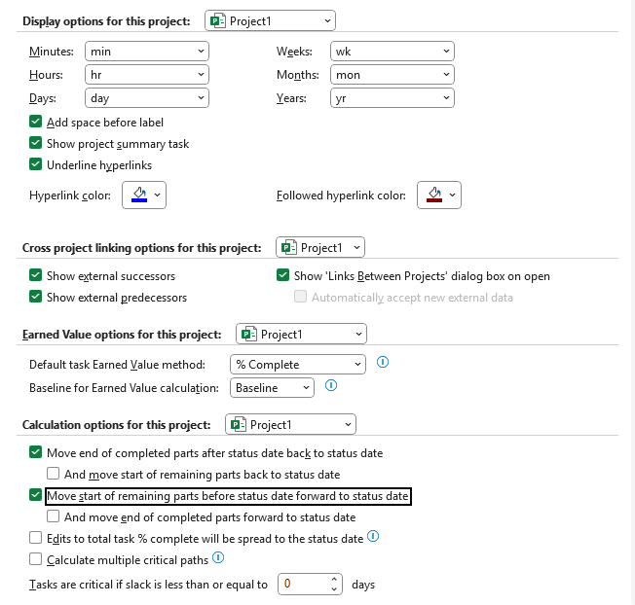
Advanced
Recommendation
Prompt for project info for … :enabled
Automatically add resource: disabled
Show summery tasks: enabled
Move end of completed part: enabled
- And move start.. : ?
Move start of remaining part: enabled
- And move start.. : disabled

Slide 16
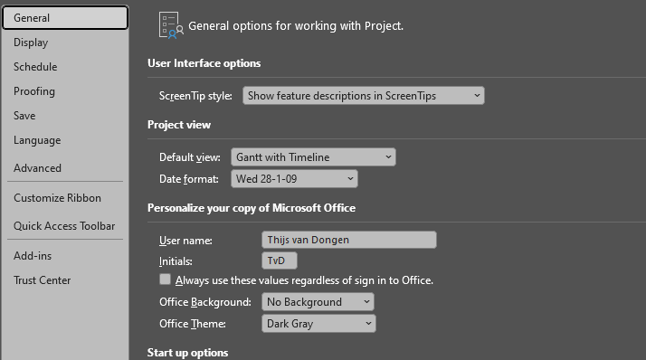
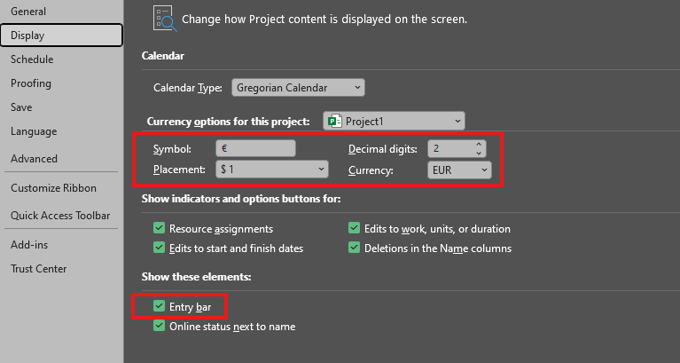
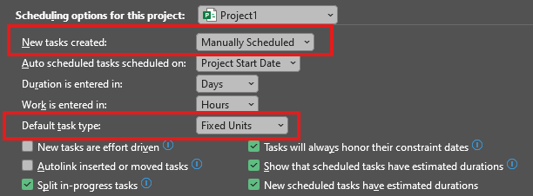
Settings everyone
Default view: Gantt with Timeline
Date format: day & date
Symbol: €
Entry bar
New tasks created : Manually scheduled
Auto scheduled: Project Start date
Default task type: fixed Unites
New Tasks are effort driven

Slide 17
Practical task 1
CH02 Practical Task 1

Slide 18
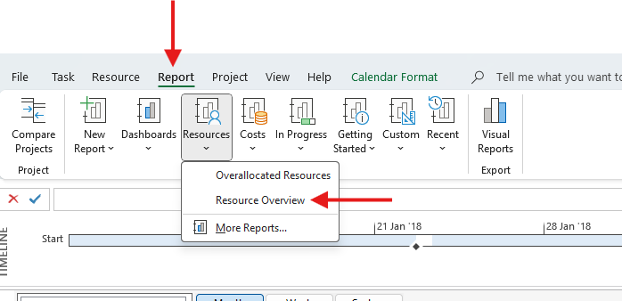
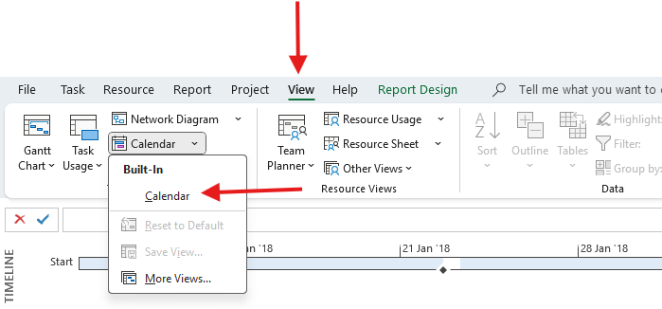
Resource View & Calendar
WBS example.mpp (MS-project)

Slide 19
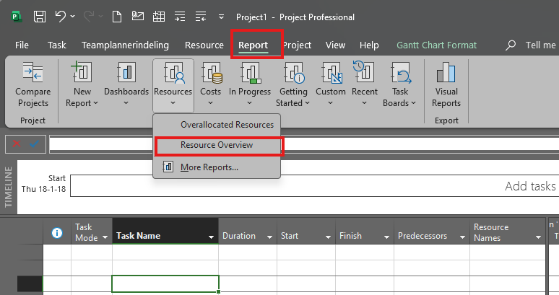
CH02 Practical TASK 1
TakeGuidedTour.MPP
Resources
Reports
  Dashboard
  Resources
    Resource Overview
Link to files

Slide 20
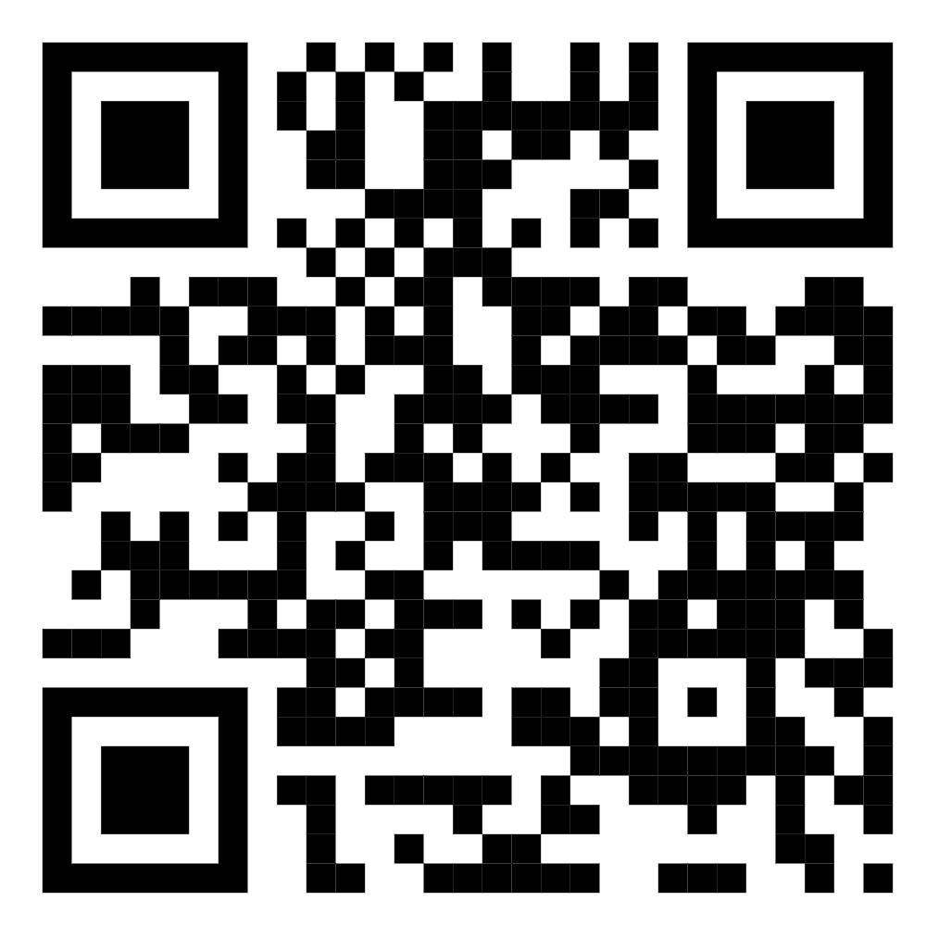
Practical files
https://1drv.ms/f/c/cedf024df8b0d021/Eg4kpRgsPilIuYJnH2r034IB99xR7-TZHsBT46x5q2VQzw?e=byELB8

Slide 21
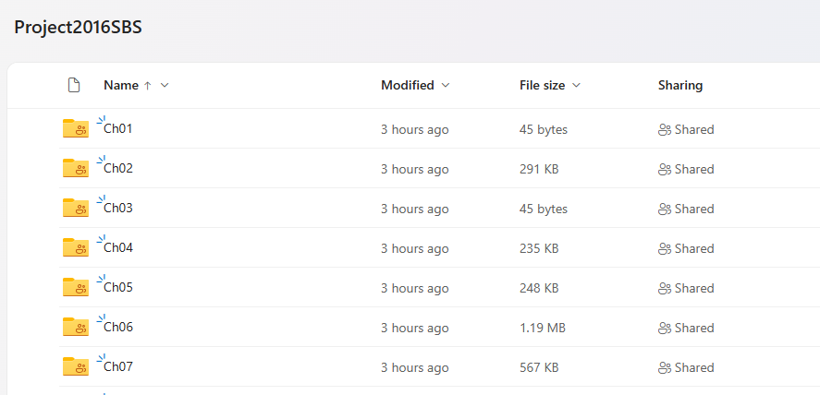
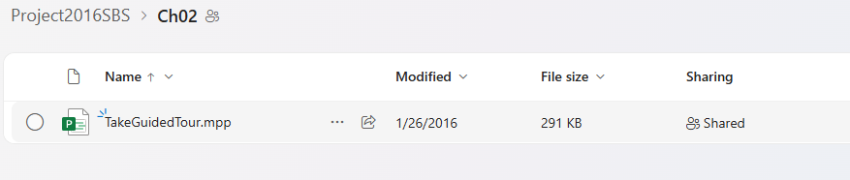

Slide 22
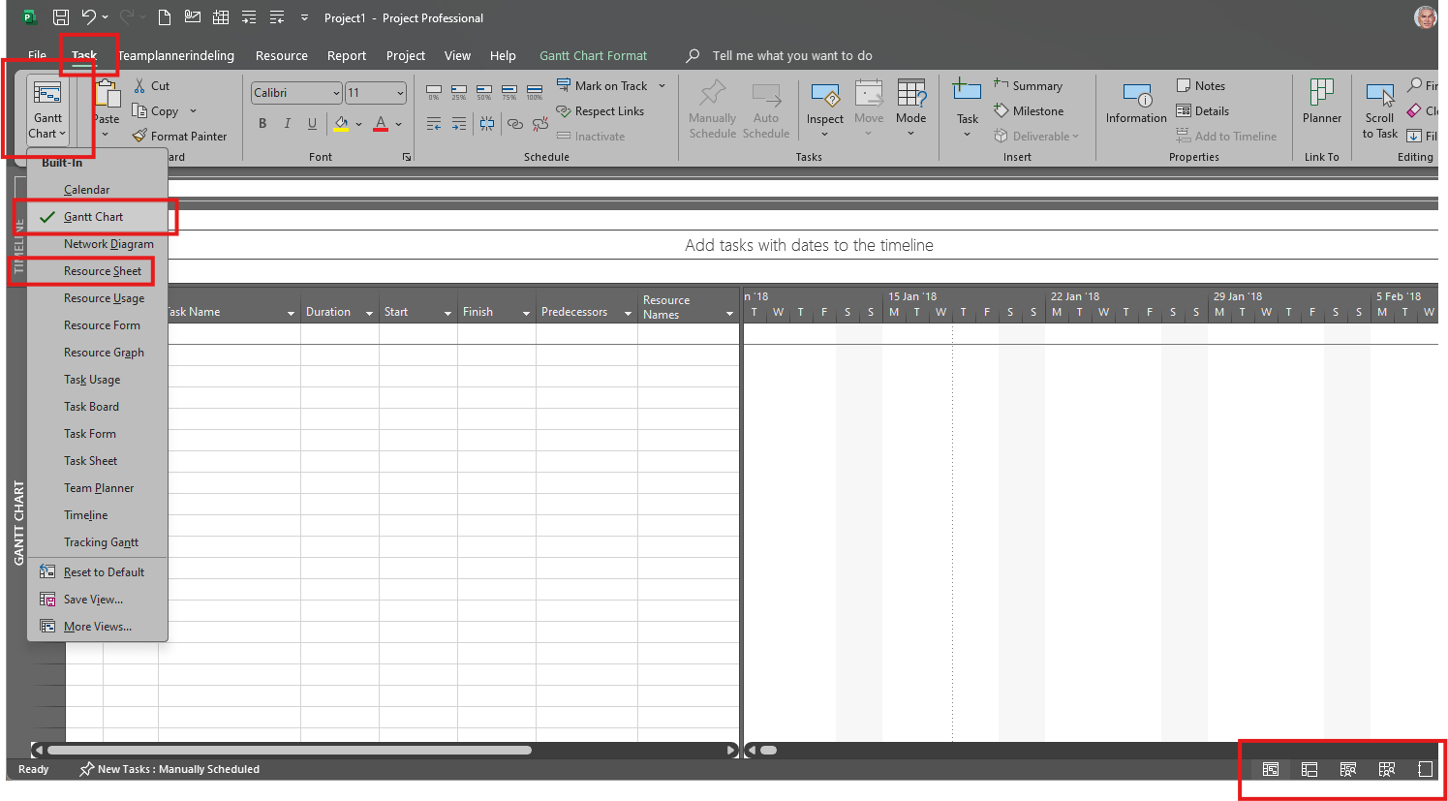
Most important of the office ribbon
End chapter

Slide 23
Project information
In het lint
Info in het bestand

Slide 24
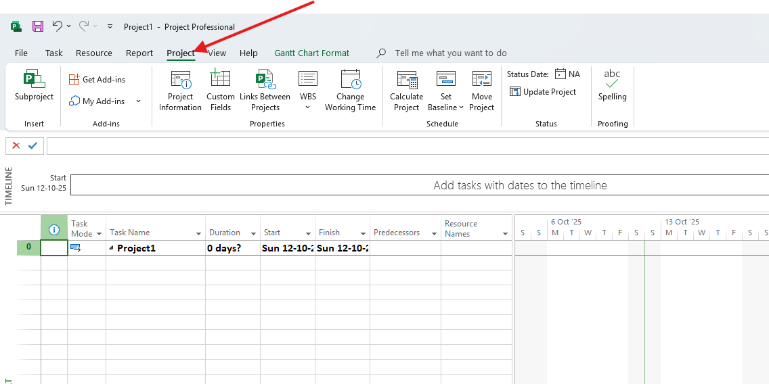
Project information (1)

Slide 25
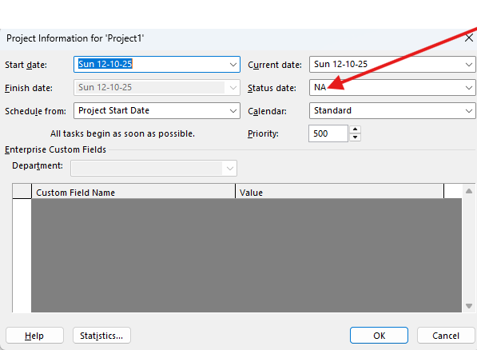
Project information (2)
Don’t update this, all calculated values will be updated!

Slide 26
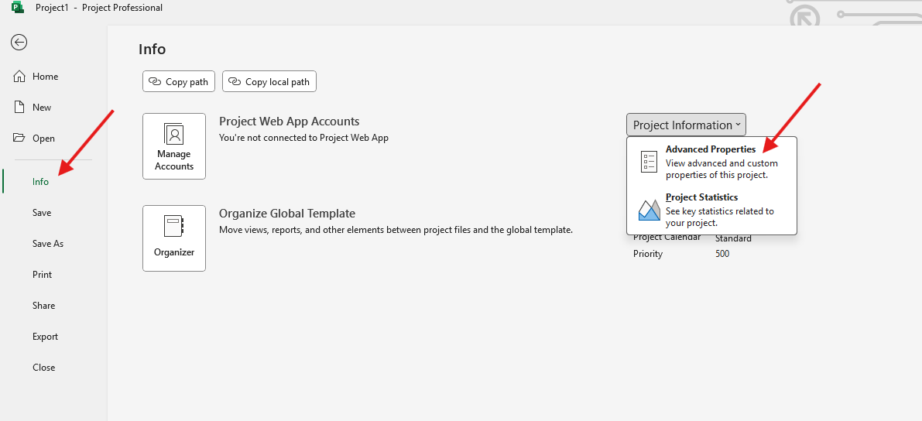
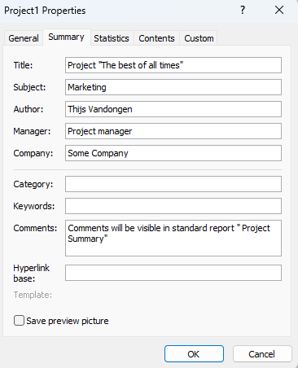
Project information (3)

Slide 27
CH03 Practical TASK 2
New plan
Start date 18-01-2018
Nonworking day 18-01-2018
Properties project
Subject: New book launch schedule
Manager: Carole Poland
Company: Lucerne Publishing
Comments: New children’s book for spring release
End chapter

Slide 28
Calenders
Project
Resource
Task

Slide 29
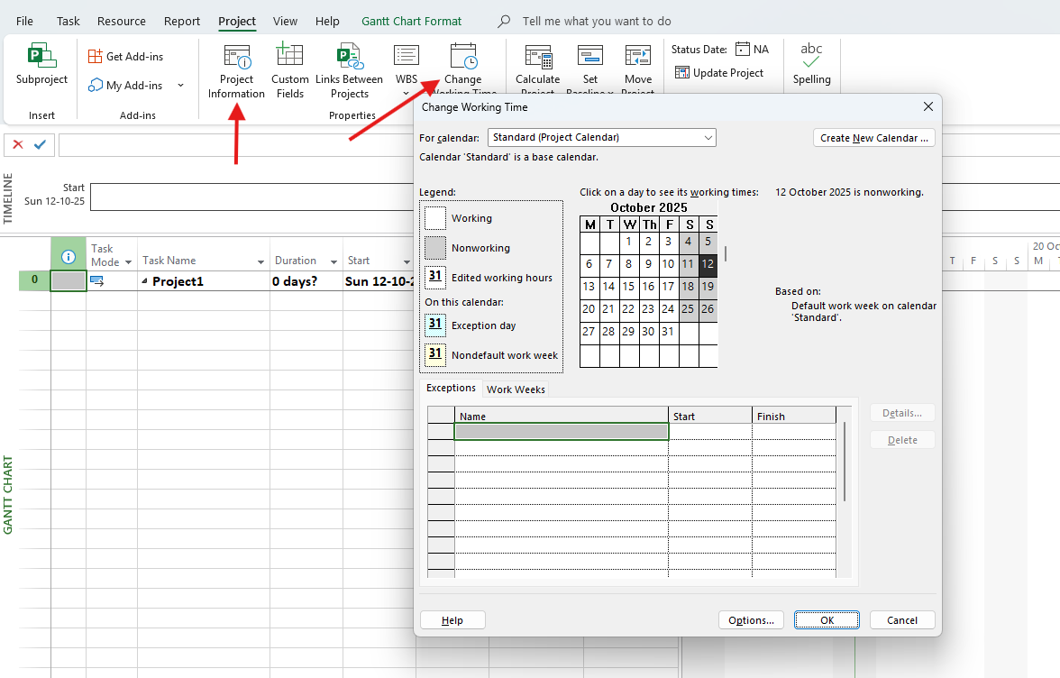
Project calendar

Slide 30
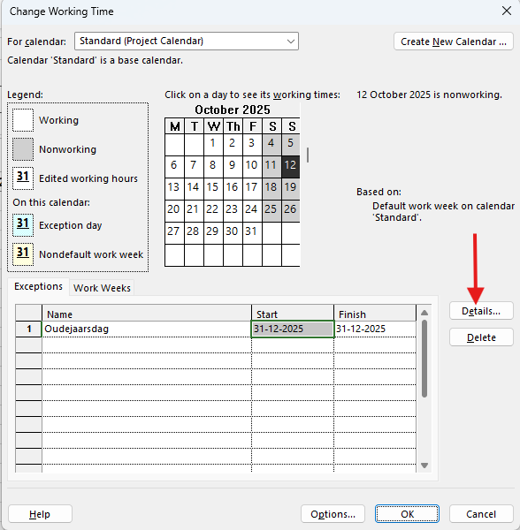
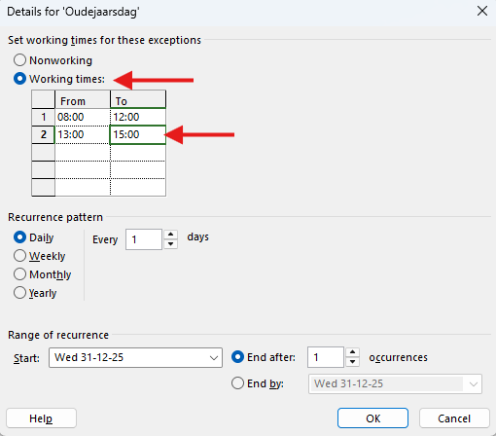
Change a day

Slide 31
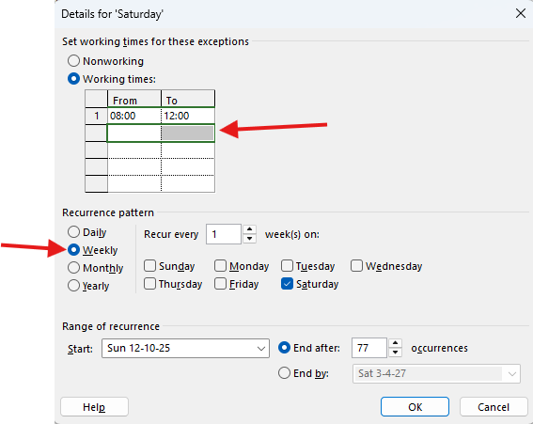
Make a weekend a working day
Use “Del” to delete 13:00 – 17:00
(Mac fn – Backwards)

Slide 32
Feestdagen Nederland
Nieuwjaarsdag: donderdag 1 januari
Goede Vrijdag: vrijdag 3 april
Eerste Paasdag: zondag 5 april
Tweede Paasdag: maandag 6 april
Koningsdag: maandag 27 april
Bevrijdingsdag: dinsdag 5 mei
Hemelvaartsdag: donderdag 14 mei
Eerste Pinksterdag: zondag 24 mei
Tweede Pinksterdag: maandag 25 mei
Eerste Kerstdag: vrijdag 25 december
Tweede Kerstdag: zaterdag 26 december

Slide 33
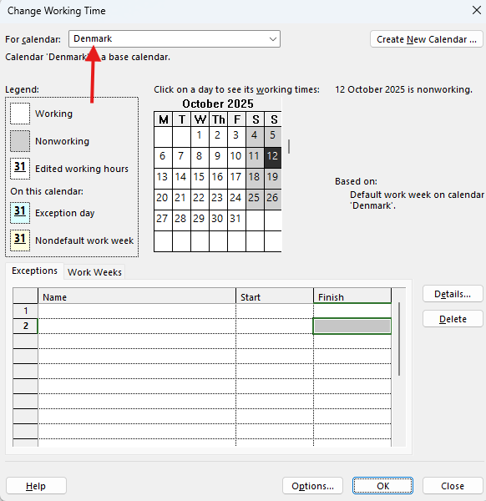
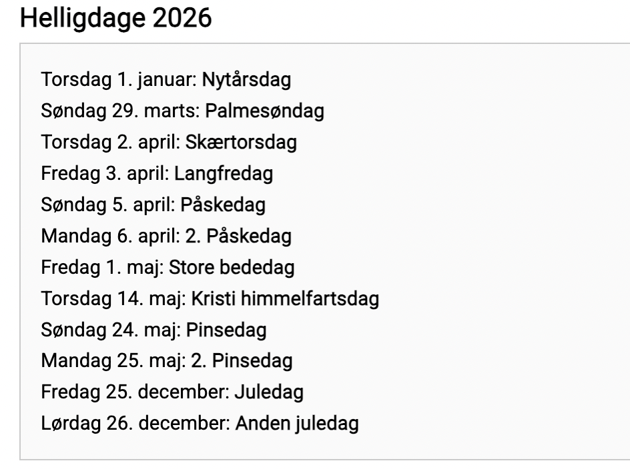
New calendar – Denmark (2026)
Notes:
Nieuwjaarsdag: 1 januari
Palmpasen: 29 maart
Pasen: 3 april
2e Paasdag: 6 april
Grote Vrijdag: 10 april
Gebedspost: 8 mei
Hemelvaartsdag: 14 mei
Pinksteren: 24 mei
2e Pinksterdag: 25 mei
Dag van de Grondwet: 5 juni
Midzomer: 24 juni
Kerstmis: 25 december
2e Kerstdag: 26 december

Slide 34
Work Break Down Structure (WBS)

Slide 35
Demo: taken invoeren
3 teken en dan een samenvattende taak
Eerst fasen en dan de onderliggende taken

Slide 36
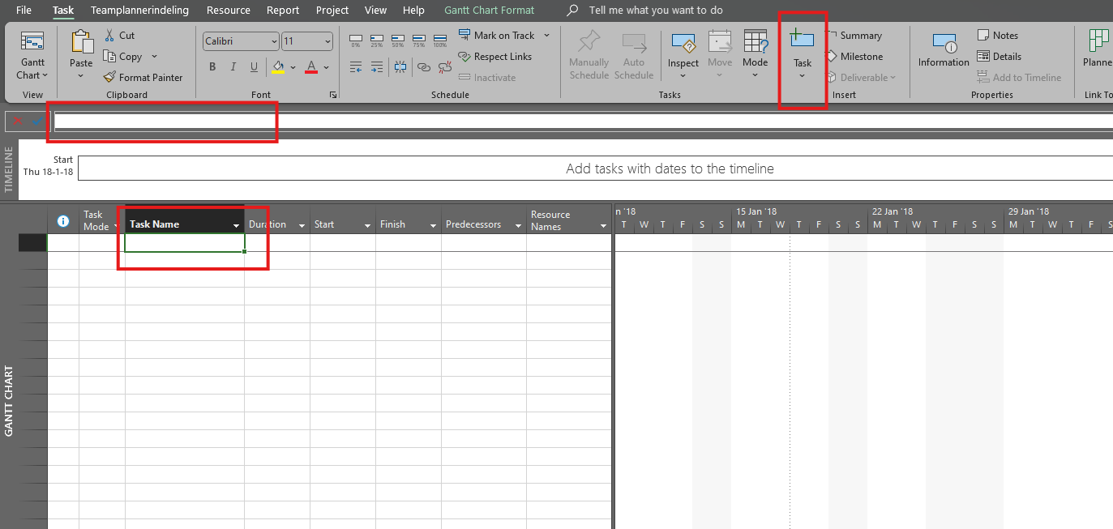
Create task or milestone
Insert button

Slide 37
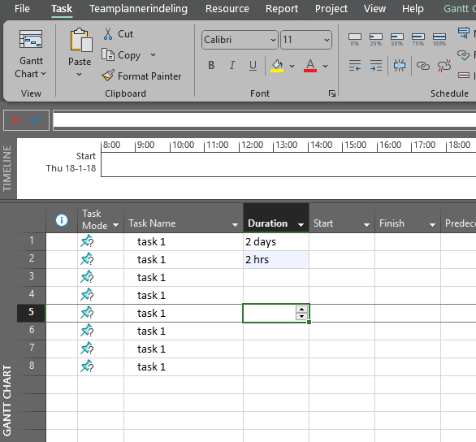
Fill in task duration or dates
Insert knop

Slide 38
Top-down of bottom-up
Top-down
  Start with different phases
  First summary task and then detail tasks
Bottom-up
  First the details
  Then summarize
  End determined

Slide 39
Create summary tasks to outline the plan
Indent increase or decrease
Click multiple task and create summarizations

Slide 40
Opdracht: taken invoeren
Instelling: handmatige scheduled –Projectnaam: De grote verbouwing
Voorbereiding
  Maken bouwplannen
  Aanvragen vergunning
  Contracteren aannemer
Uitvoering
  Slopen en bouwen
  Installeren keuken
  Afwerken geheel
Afronding
  Goedkeuring bouwinstantie
  Feestje

Slide 41
Demo: mijlpalen
Mijlpaal direct invoeren
Taak via duration = 0 maken
Taak details gebruiken

Slide 42
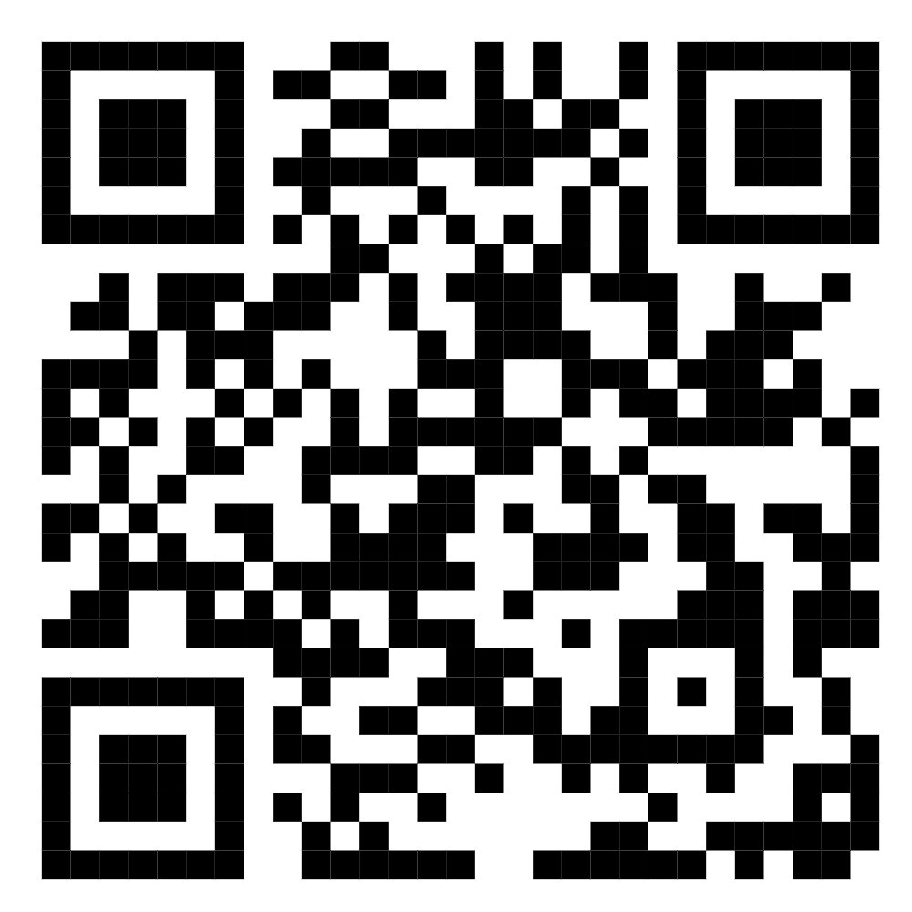
Bestanden van de syllabus
https://1drv.ms/f/c/cedf024df8b0d021/EojbofAxZz9Eu_9TLOPFAeUBrhUMItHKRHxK6ap_RWnLgg?e=w6r4LC

Slide 43
Opdracht: Mijlpalen invoeren
Gebruik : Project2025-3.mpp
Voorbereiding
  vergunning verleend
  Voorbereiding gereed
Uitvoering
  Start bouw
  Goedkeuring fundering
  Uitvoering klaar
Afronding
Einde projectverbouwing

Slide 44
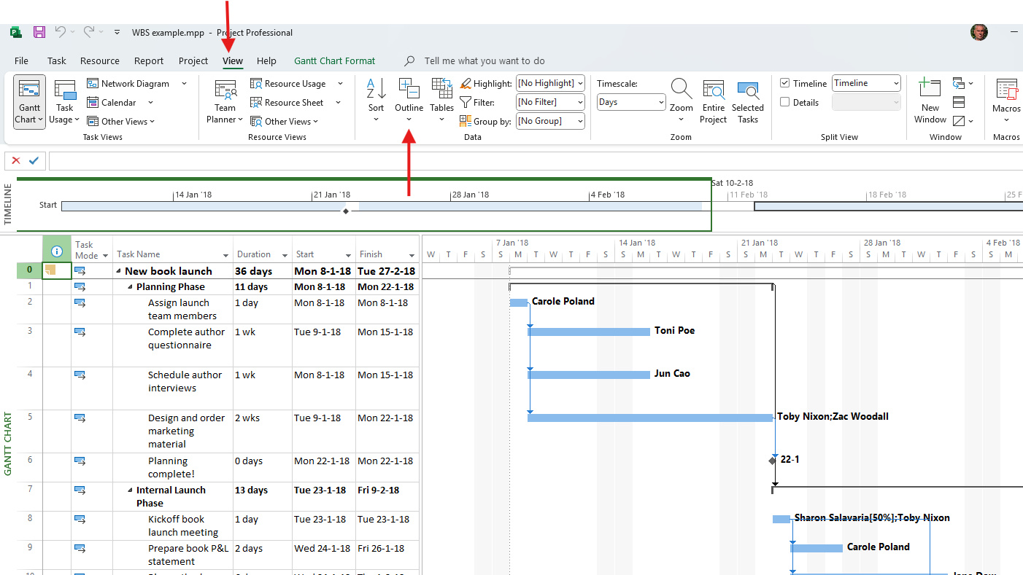
Use of outline

Slide 45
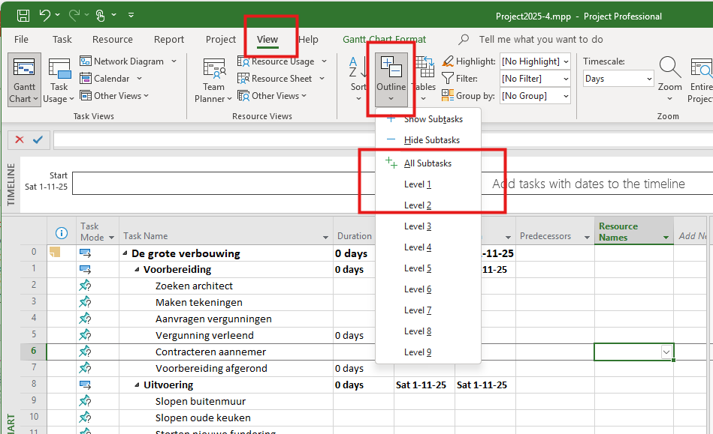
Opdracht: Outline
Gebruik : Project2025-4.mpp

Slide 46
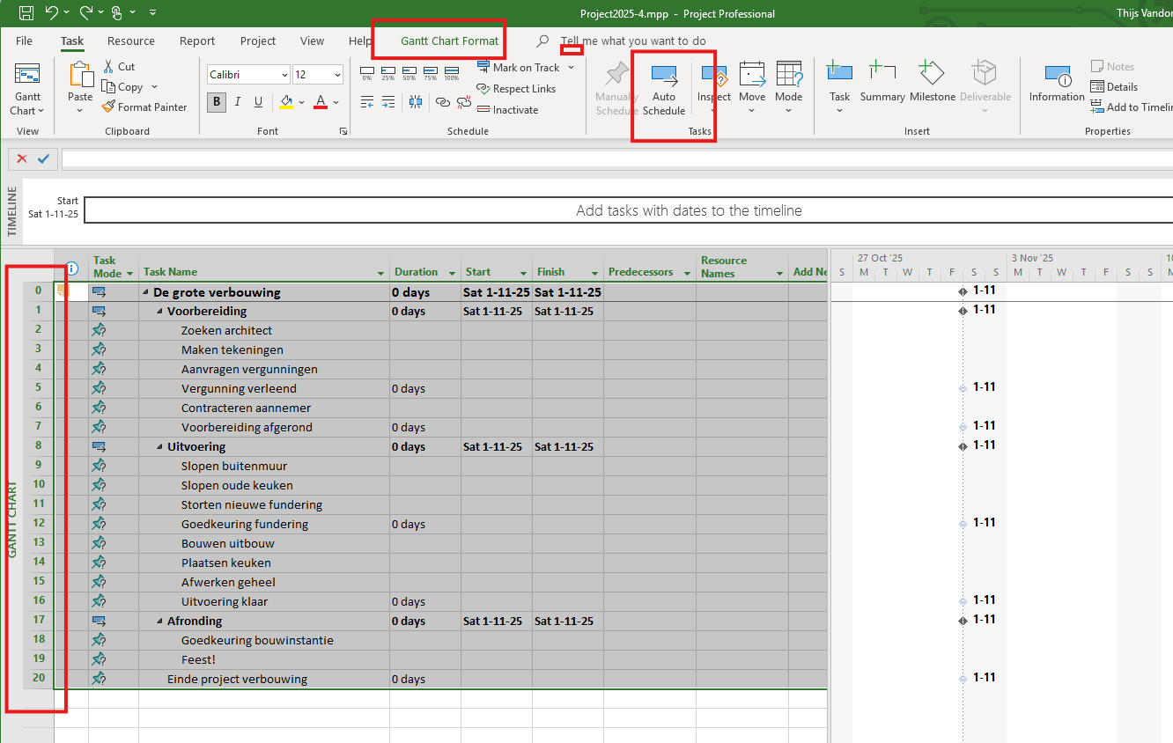
Opdracht: Maak alle taken automatisch
Gebruik : Project2025-4.mpp

Slide 47
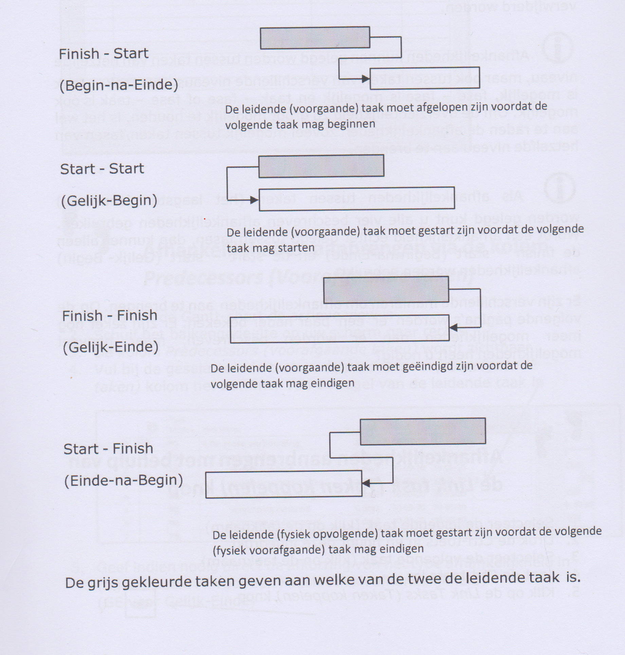
Afhankelijkheden

Slide 48
Opdracht: afhankelijk
Gebruik : Project2025-5.mpp
De voorbereiding moet in zijn geheel zijn afgerond voordat de uitvoering kan beginnen
Pas als de architect is gevonden (en aangenomen) kan begonnen worden met het uitwerken van het ontwerp (de bouwtekeningen)
Zodra de bouwtekeningen gereed zijn kan de vergunning worden aangevraagd. Uiteraard kan pas daarna de vergunning verleend worden
Pas als de vergunning definitief is zal de aannemer worden gecontracteerd.
Nadat de aannemer is gecontracteerd zijn we klaar met de voorbereiding.
Zodra de bouw van start kan, kunnen gelijktijdig de sloop van de buitenmuur en de sloop van de keuken beginnen. Om zeker te zijn dat zulks ook gebeurt moet de afhankelijkheid in de planning worden opgenomen.
Zodra de buitenmuur gesloopt is kan worden begonnen met het storten van de nieuwe fundering. Zodra dat achter de rug is kan de fundering worden gekeurd.
De bouw van de uitbouw is afhankelijk van zowel de nieuwe fundering als de sloop van de oude keuken
Als de uitbouw af is kan worden begonnen met zowel het plaatsen van de keuken als het afwerken.
Als de keuken af is en het afwerken (ook aan de binnenzijde), is de uitvoering klaar.
De goedkeuring door de bouwinstanties gaat alleen over de fundering en de structurele kwaliteit van de uitbouw. De keuken zelf heeft daar geen invloed op. Zodra de uitbouw af is kan de inspectie plaatsvinden.
Als de uitbouw is goedgekeurd én de uitvoering is geheel af, dan is het tijd voor een feestje om de nieuwe keuken in te wijden.
Na het feest kan het project worden afgesloten..

Slide 49
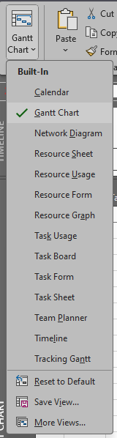

Guided Tour MS-project
Quick Access - Ribbon – Tabs
Screen tips
Right Mouse button
  Task
  Bar
Templates
  Set once, use many times
  Examples
Table view
Gantt Chart

Slide 50
Explore the Project user interface – Task / Resource
Task, Resource, Project
Views -> Gant-chart – Resource – Task
Schedule -> 0 until 100% or “Update”
Assign Resources
Resource pool
Level

Slide 51
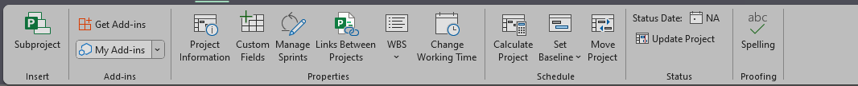
Explore the Project user interface – Project / View - Table
Baseline
Update project
Subprojects
Tables
Time scale
Timeline

Slide 52
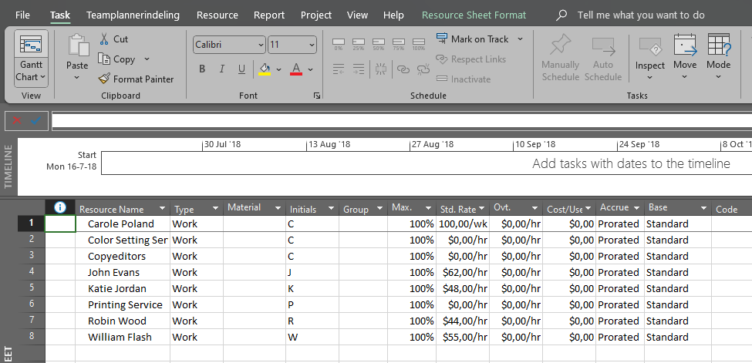
Resource sheet

Slide 53
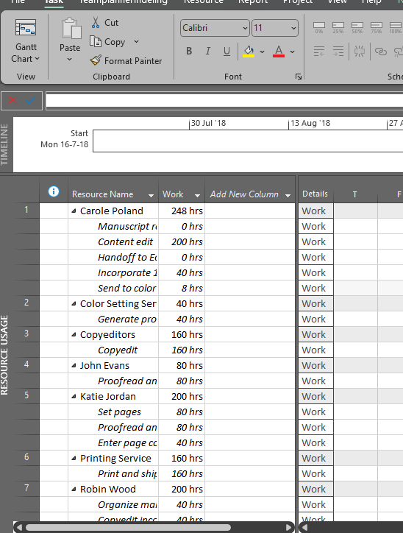
Resource usage

Slide 54
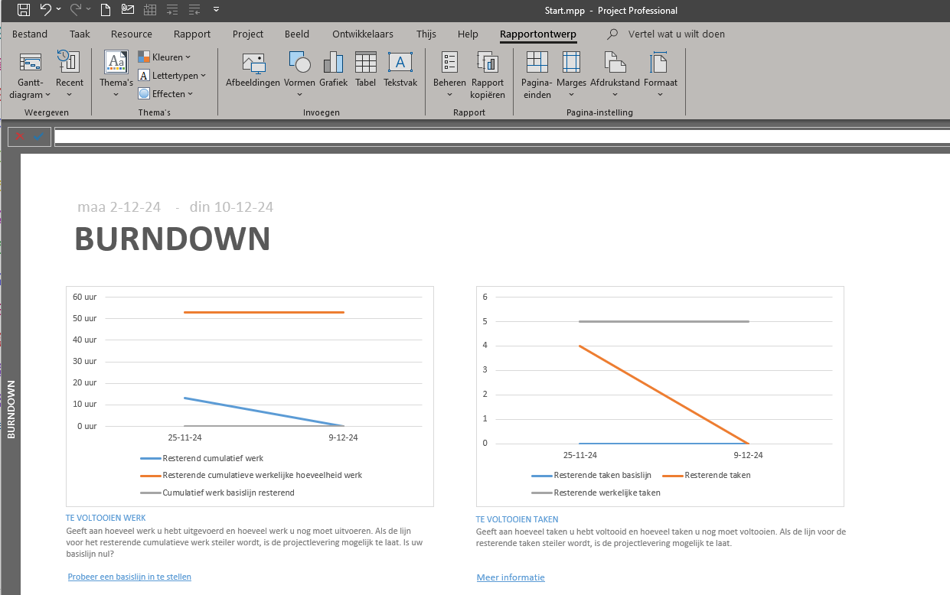
Reports

Slide 55
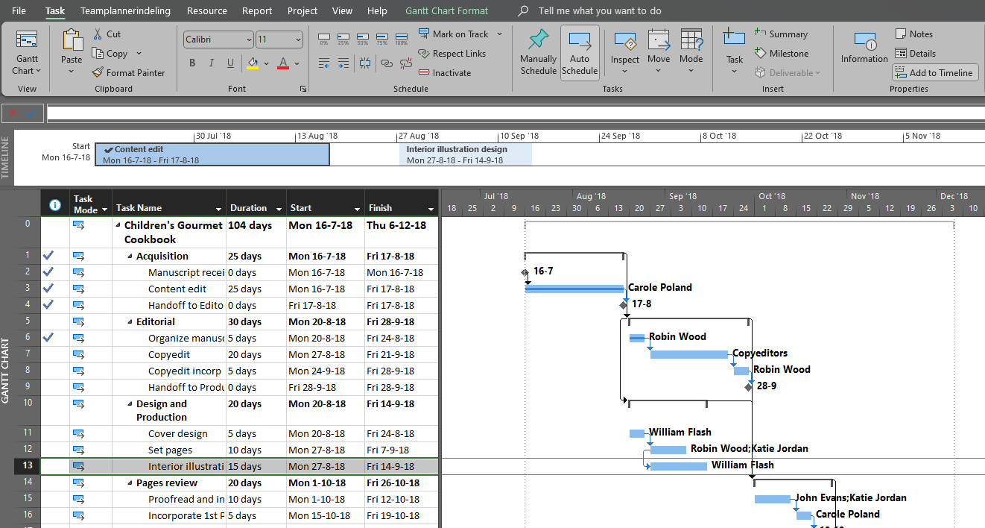
Timeline

Slide 56
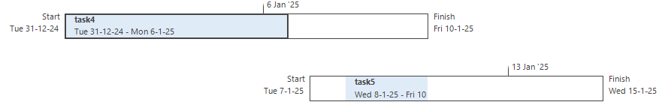

Slide 57
Task - topics
Create task
Adjust task duration & dates
Milestones
Summary tasks
Dependency between tasks
Task Manual to Automatic
Check plan duration and end date

Slide 58
Making tasks dependent
Drag and drop
Task details
Gantt - table
Ctrl – select
Menu

Slide 59
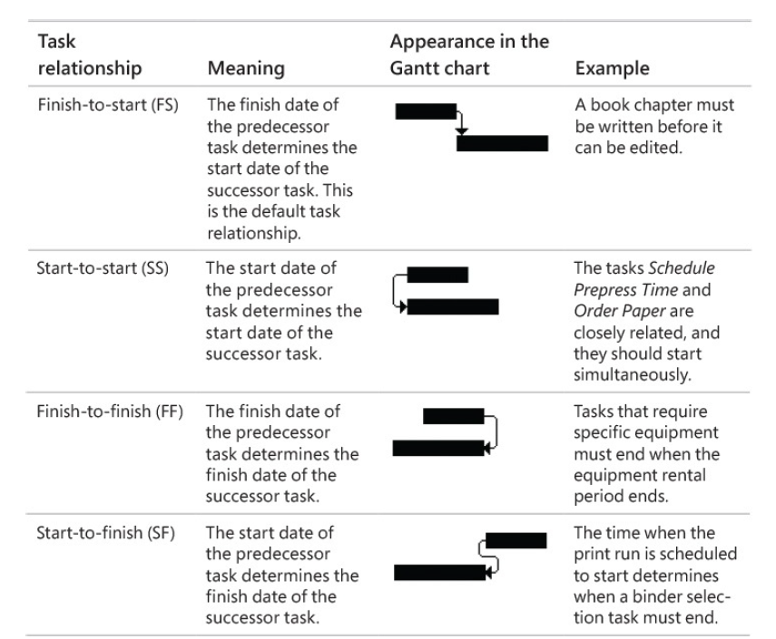
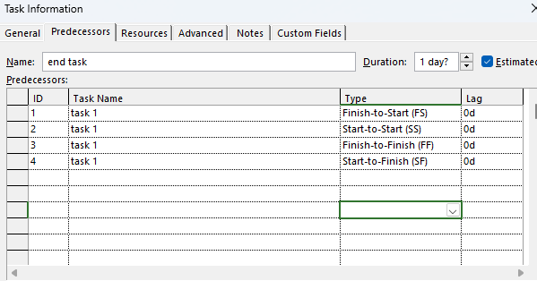
Link tasks

Slide 60
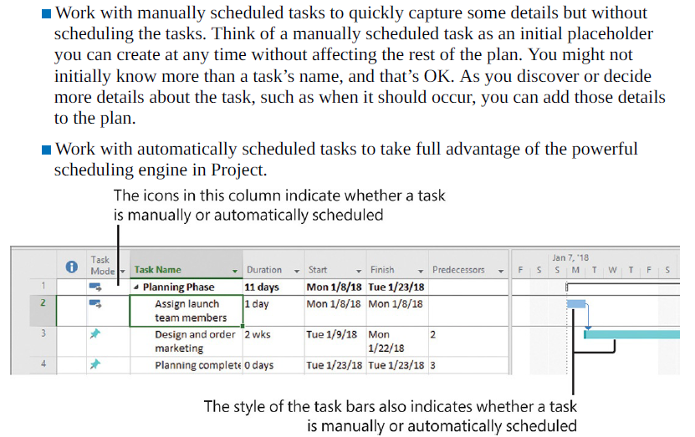
Taken Modes

Slide 61
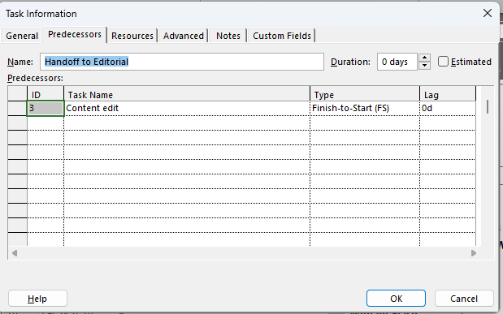
Task all fields (information)
Add a note
Add a hyperlink (right click)

Slide 62
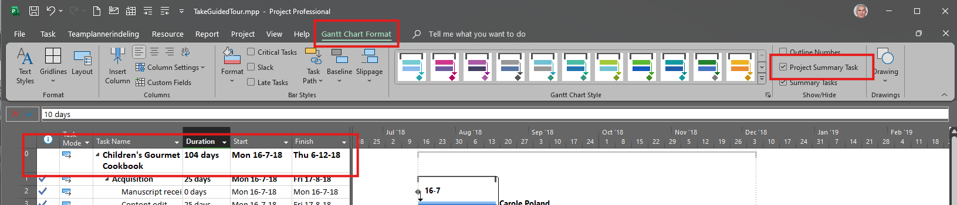
Project summary task

Slide 63
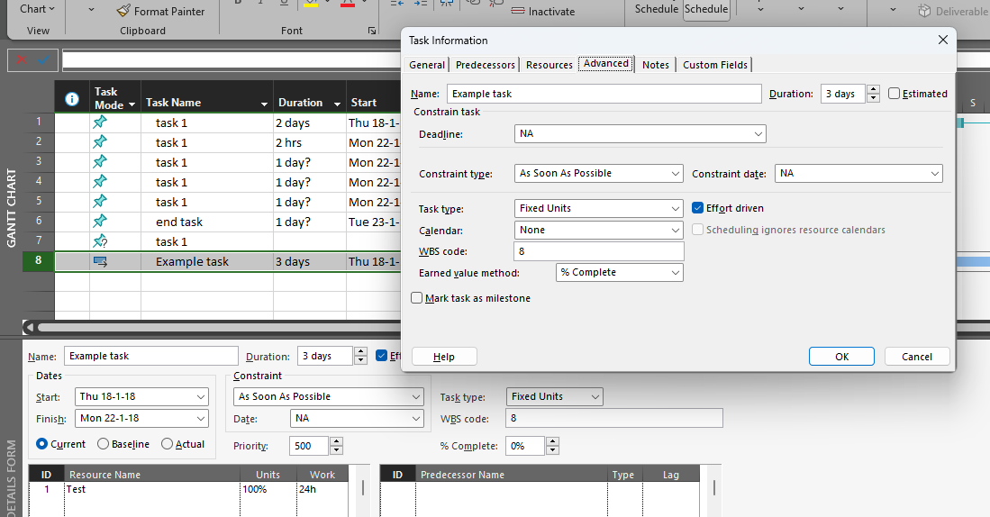
Task options

Slide 64
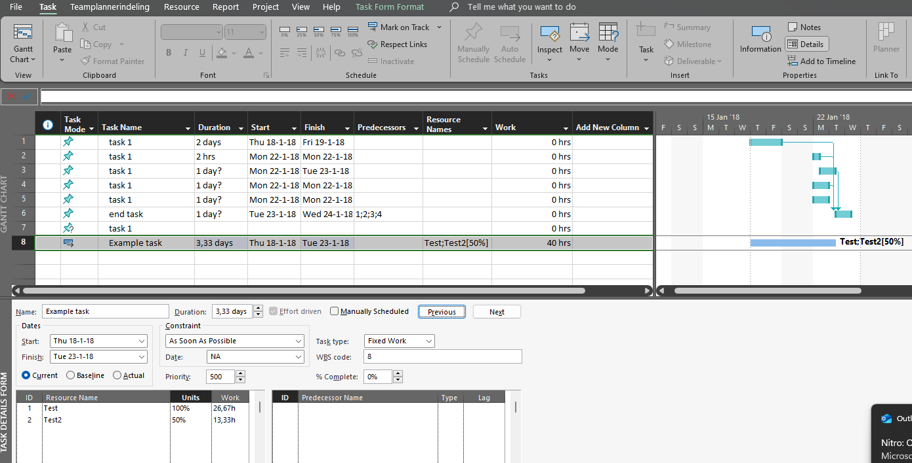
Task type
Fixed units, effort driven (initially)
Fixed duration, more resources, more hours
Fixed work, more resources, shorter duration
Fixed units, percentage per resource fixed

Slide 65
Chat GPT
In Microsoft Project, a Task Type defines how the software calculates changes to tasks when you modify one of the three key variables:
Work (the total effort required to complete the task)
Duration (the amount of time the task will take)
Units (the number of resources assigned, often shown as a percentage)
MS Project uses these relationships:
Work = Duration × Units

Slide 66
Task type fixed Units
Fixed Units
Default setting in MS Project
Units (resources assigned) stay constant.
If you change the duration, MS Project recalculates work.
If you change work, it recalculates duration.
Example:
If a task has 2 resources (200% units) and takes 2 days (duration), the total work is 2 resources × 2 days = 4 days of work.
If you increase the duration to 4 days, MS Project keeps 2 resources and updates the work to 8 days.

Slide 67
Task type fixed Work
Fixed Work
Work stays constant.
Changing duration will change units.
Changing units will change duration.
Best when: You know exactly how much effort is needed (e.g., 16 hours of work), regardless of how long it takes or how many resources are assigned.

Slide 68
Task type fixed Duration
Fixed Duration
Duration stays constant.
Changing units will change work.
Changing work will change units.
Best when: The task must be completed in a specific time frame, no matter how many resources are available.

Slide 69
Task type – what happen
Task Type | What stays fixed | What changes when you edit duration | What changes when you edit work | What changes when you edit units
Fixed Units | Units | Work | Duration | Work
Fixed Work | Work | Units | Duration | Duration
Fixed Duration | Duration | Work | Units | Work

Slide 70
Task – effort driven
The effort driven field indicates whether the scheduling for a task is effort driven.
The total task work stays the same regardless how many resources are assigned.
The remaining work is distributed to them.

Slide 71
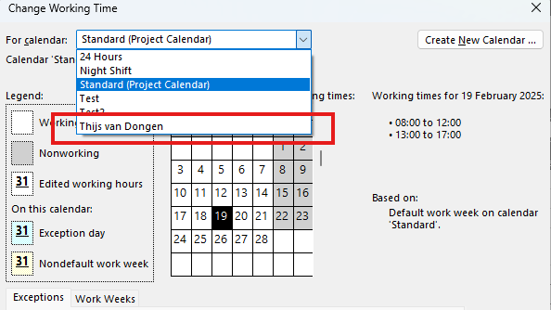
Resources
Resource Sheet
  New
  Insert
  Delete
Maximum capacity
  100% per person
  X00% for a group of x resources
Rates
  Normal
  Overrate
Costs of item
Adjust the calendar, or
one calendar per person/group
Adjust working hours

Slide 72
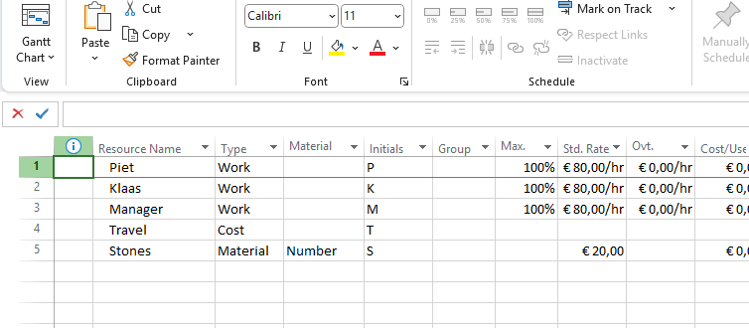

Resources
Resource Sheet
  Work
  Cost
  Material
Financials
  Total

Slide 73
CH05 Practical TASK 4
The SimpleSetUpResources practice file for these tasks is located in the
Project2016SBS\Ch05 folder
  Create resources
  Maximum capacity
  Rates & costs
  Working time per resource
  Add a note

Slide 74
What we learned about resources
Create a resource
Maximum capacity
Rates
Working hours
Cost resource
Resource Note
End chapter

Slide 75
Day 1 – looking back
What did you learn?
What do you still have trouble with?
What went well?
What could be better?
What do you want to practice next week?
What do you want to learn next week?

